Slide 1
Agenda
Introductions & What’s New in Azure Databricks
Modern Data Architecture with Azure Databricks & Synapse
Delta Demo & Code Along (Notebooks in https://academy.databricks.com/class/register)
Competitive Plays & Positioning
Break (~15min)
Machine Learning With Azure Databricks
Machine Learning Demo & Code Along (Notebooks in https://academy.databricks.com/class/register)
Hadoop Migrations & Vertical Plays
Wrap Up & Capstone

Slide 2

Data Science
with Azure Databricks

Slide 3
Data Science/ML experience on Azure Databricks

Slide 4
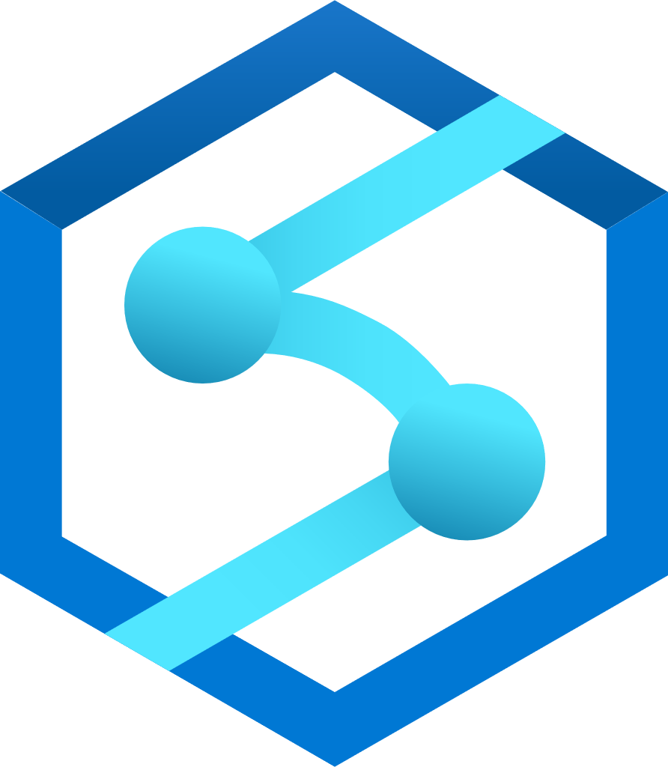
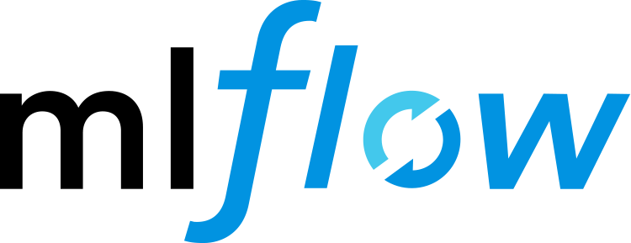

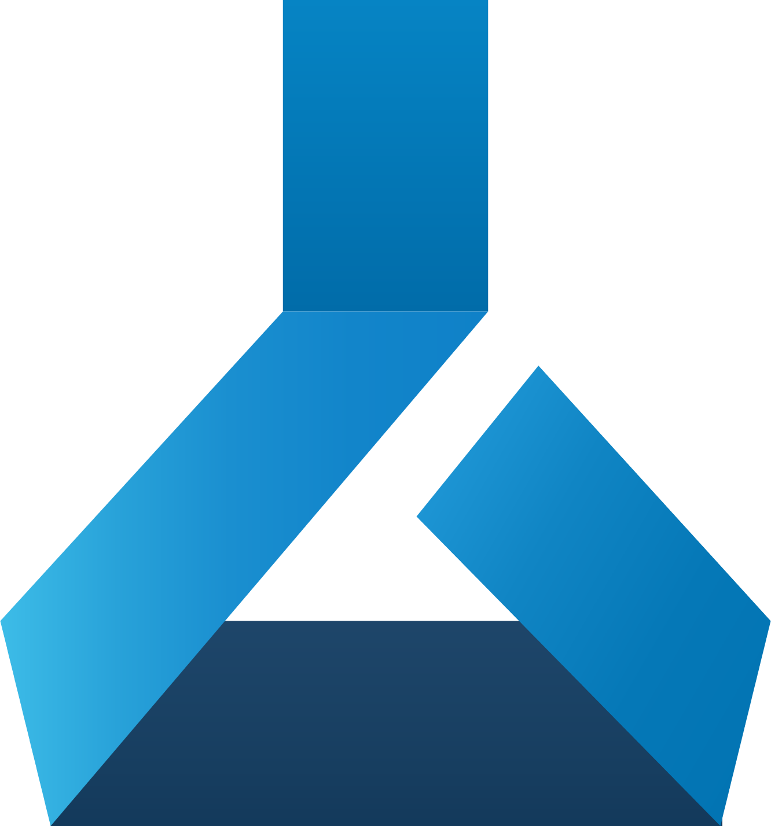

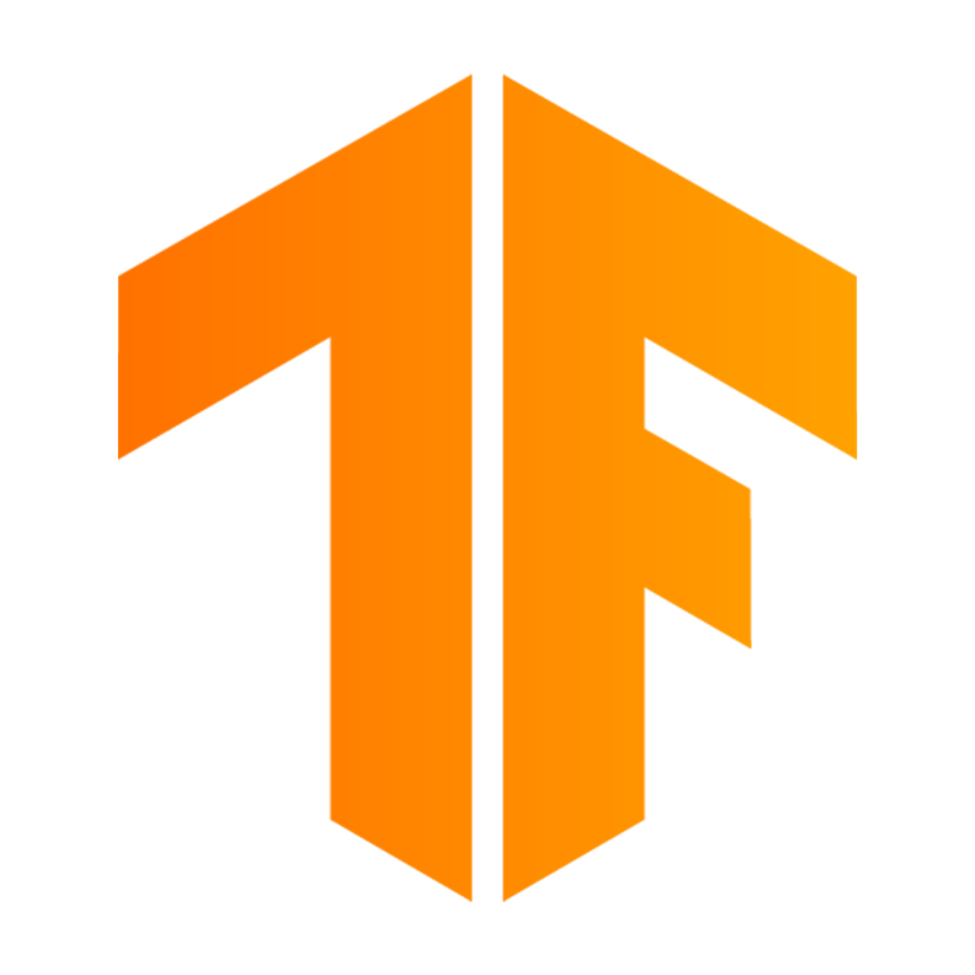
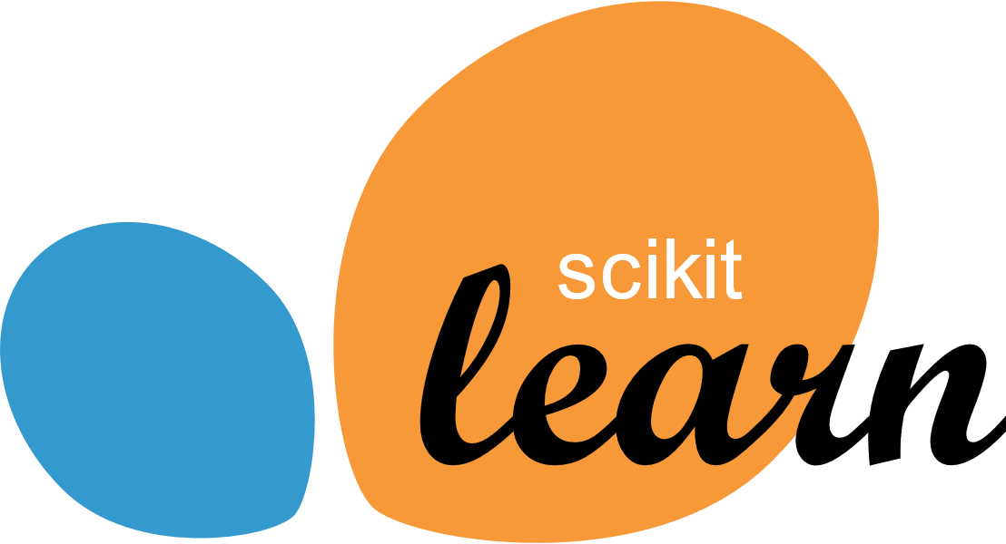
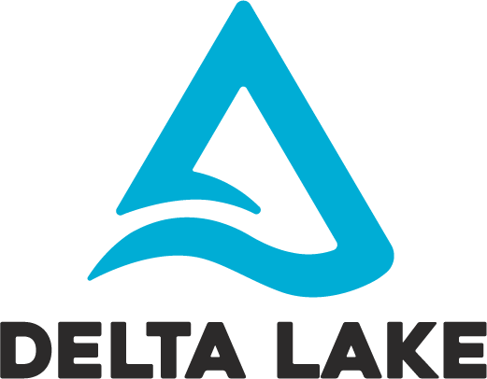


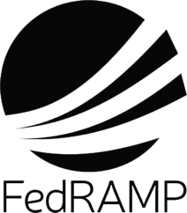





Azure Databricks accelerates data science
Azure Databricks
Collaborative workspace for data teams across the full lifecycle
Data engineer
Data scientist
Azure Data Services integrations
ML Lifecycle Management integrations
Azure Data Factory
Azure Synapse Analytics
MLflow
Azure Machine Learning
Native integration with Azure Machine Learning and other Azure Data Services
ML Runtime
Power BI
Azure Data Lake Storage
PyTorch
TensorFlow
Scikit-Learn
Databricks Runtime
Scalable, reliable, and fast data - built on your existing data lake powered by most optimized Spark Engine
Delta Lake
Optimized Apache Spark
One fully-integrated security model for production infrastructure
Notes:
Azure Databricks enables unified collaboration with a simple & collaborative environment that enables your entire team to use interact with your data simultaneously.
Azure Databricks is scalable, reliable, with millions of server hours running per day, and processing multiple exabytes of data every month across 30 Azure regions.
With Azure Databricks, you can create clusters in seconds, and dynamically scale them up and down. We’ve made enhancements to the Databricks Runtime to make it up to 10x faster than open source Apache Spark™.
Azure Databricks implements enterprise-grade security with encryption, fine grained role-based access control and is HITRUST certified, building on the foundation of HIPAA, NIST, ISO, COBIT, and SOC 2. With these and other industry standard certifications, Azure Databricks is used for data analytics and AI across a wide variety of industry use cases, from personalized medicine and preventive healthcare to therapy discovery and highly tailored fintech services.

Slide 5
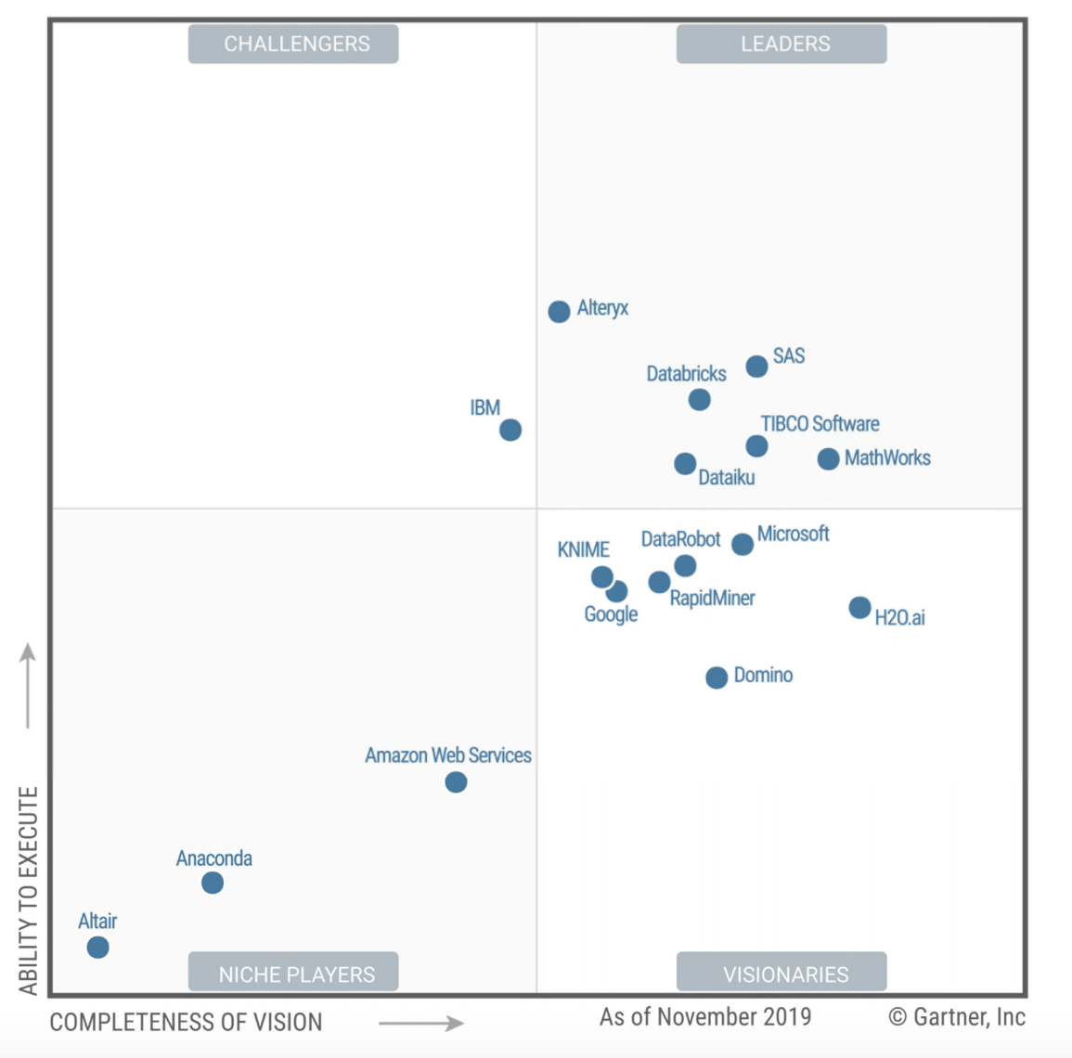
Databricks is a leader in Gartner’s 2020 MQ for Data Science and ML

Slide 6




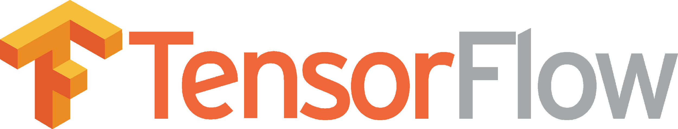



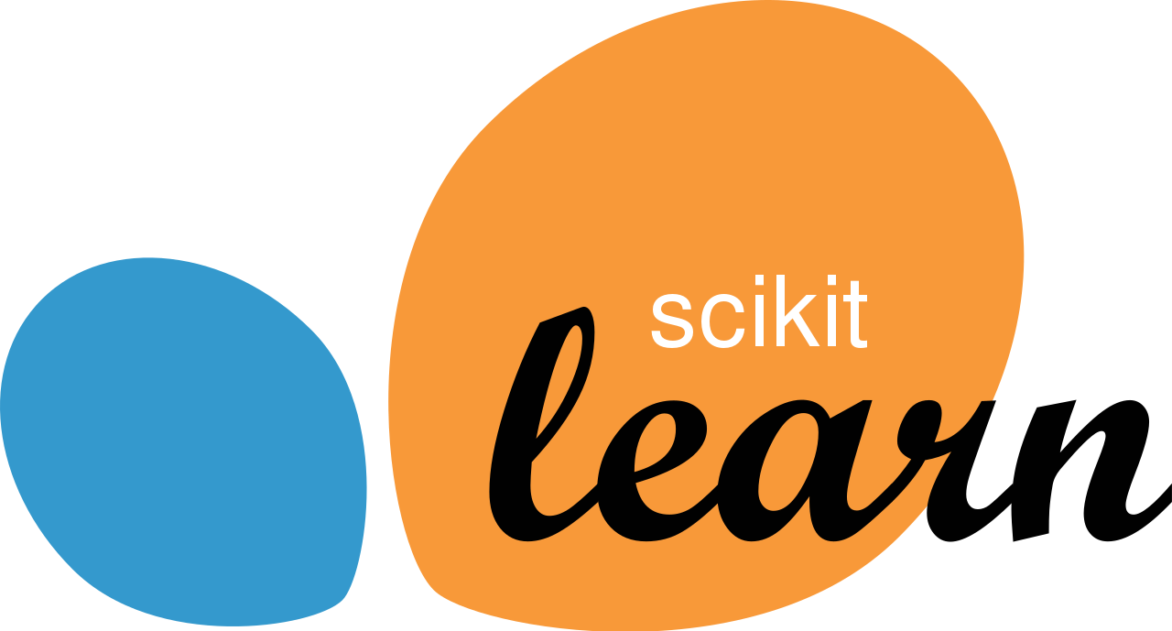
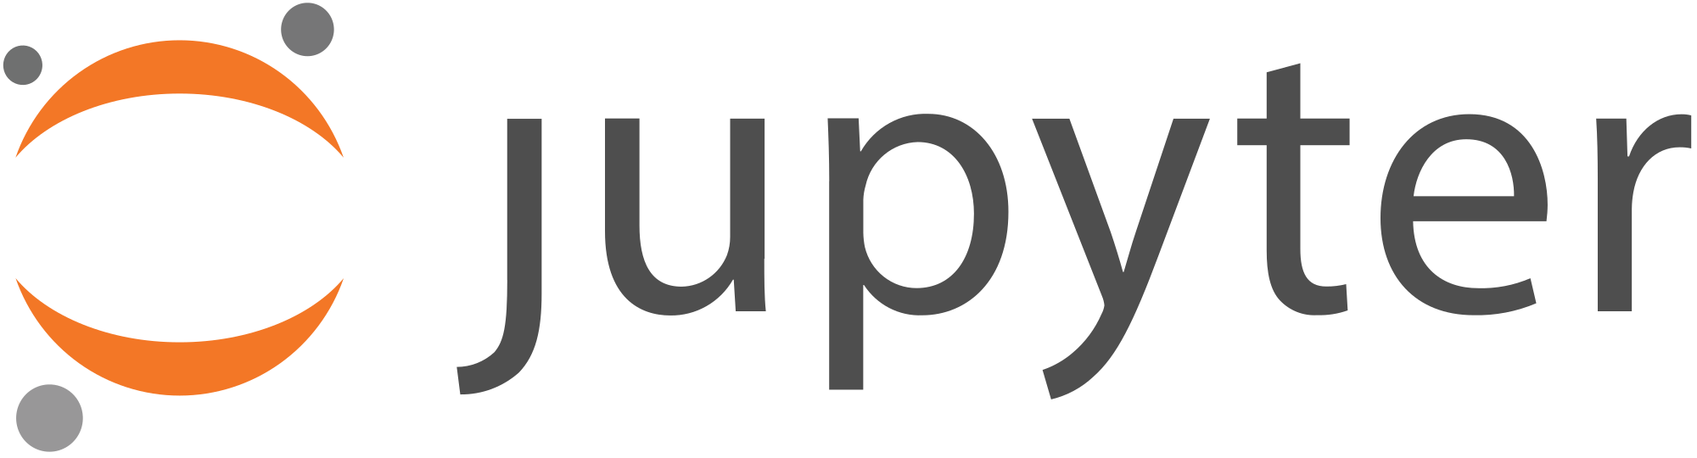





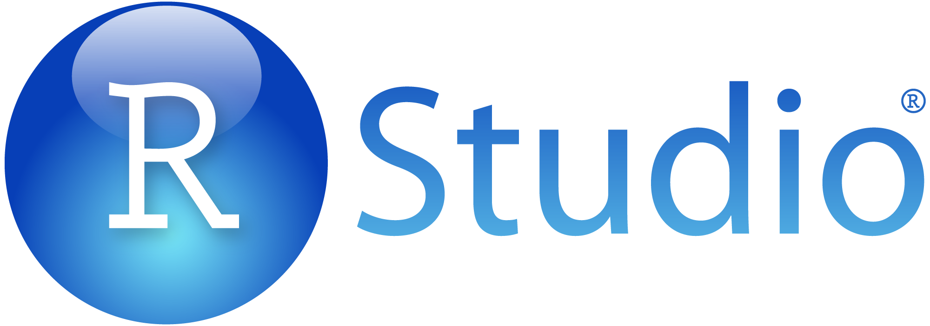
Key challenges to productivity
1
Data is messy, siloed and slow
2
A plethora of tools and frameworks
3
Productionizing ML is very hard
Warehouses
Data science
Streams
Lakes
Engineering
Data is not ready for data science and machine learning
Hard to share, manage knowledge, collaborate, and reproduce work
Error prone hand-offs slow down innovation and business impact
Notes:
1 – makes sense, start with cleaning data
2- 100%, zoo of framework
#3 – is capturing everyone's attention right now CI/CD, DevOps, Release Management.

Slide 7




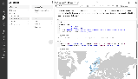

Our approach: An open and unified platform for the full data and ML lifecycle
1
High quality data, readily accessible
2
Increase data science teams productivity
3
Standardize the full ML lifecycle
Databricks Data Science Workspace with ML Runtime
High quality data sets discoverable in one place and from any source
Use the tools, languages, and frameworks of choice on one platform
Seamlessly and securely move models from experimentation to production

Slide 8









In summary, Databricks accelerates the full ML Lifecycle
One source of truth for all your data
One collaborative experience for your data teams
One standard way to manage the full ML lifecycle
Data
Building Models
Tracking
Deployment
Models
Business and Big Data
Databricks Runtime for ML
Experimental
Staging
Production
Parameters
Metrics
Complete ML lifecycle
Notes:
“Before, we had to wait 2 weeks for a process to finish before we could analyze and iterate on a ML model. Now, the same job takes an hour. We can iterate over it multiple times a day, allowing us to really understand the outcomes of our research, tweak it, make a new model, whatever, without interruption.”
VP data science, Media

Slide 9
How Azure Databricks helps Data Scientists
Standard packaging format for reproducible ML runs
Folder of code + data files with a “MLproject” description file
Distributed Machine Learning
Spark MLlib for distributed models
Migrate Single Node to distributed with just a few lines of code changes:
Distributed hyperparameter search (Hyperopt, Gridsearch)
PandasUDF to distribute models over subsets of data or hyperparameters
Koalas: Pandas DataFrame API on Spark
Deep Learning distributed training. (HorovodRunner)
Use your own tools
Multiple languages in Databricks Notebooks (Python, R, Scala, SQL)
Databricks Connect: connect external tools with Databricks (IDEs, RStudio, Jupyter…)
R support
Native R notebooks on Databricks
Python (Scikit-Learn, Pandas)
RStudio & RStudio Server integrations
Scaling and parallelizing with SparkR & SparklyR
Upcoming features
Data Science Workspace
Project-based Git integration
Share & reproduce Conda environments
Hosted JupyterLab
Hosted Shiny Apps

Slide 10
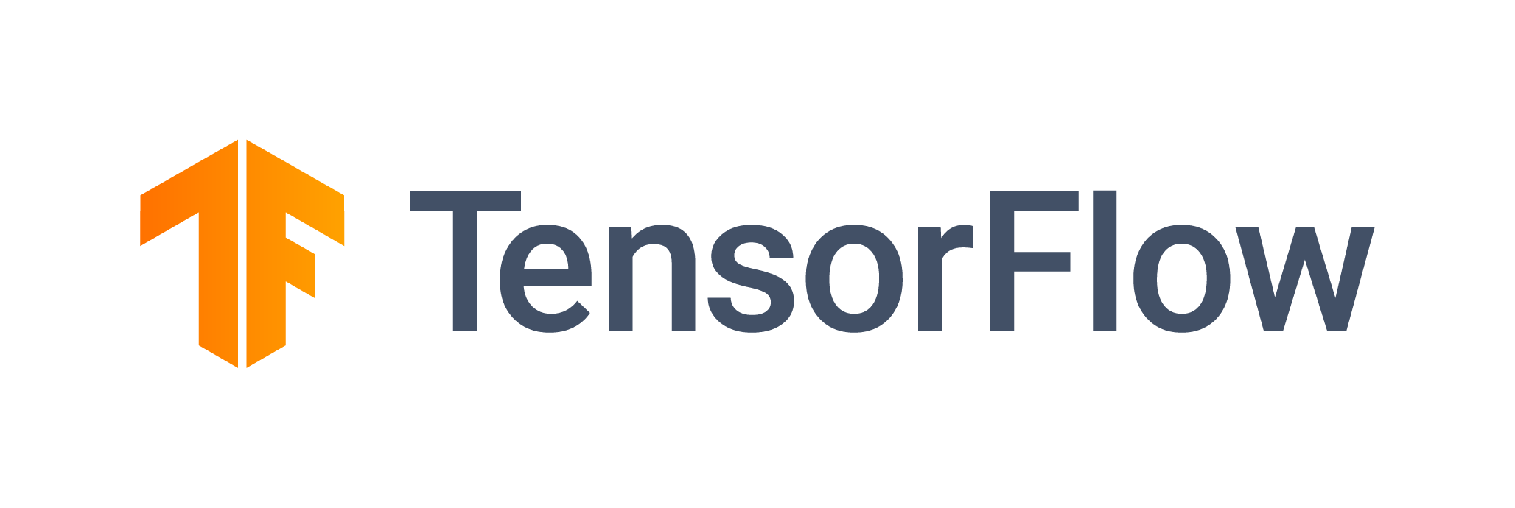


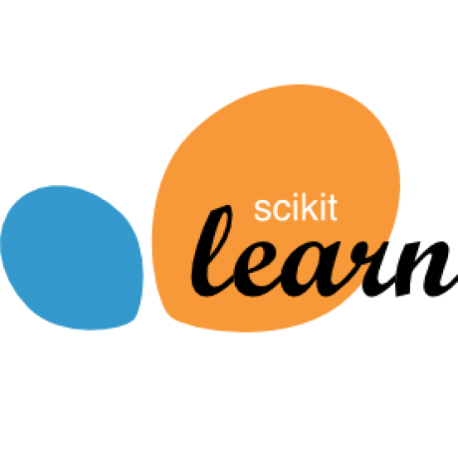

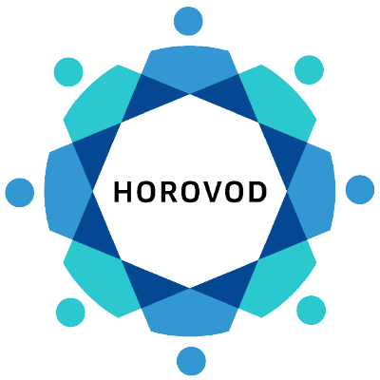


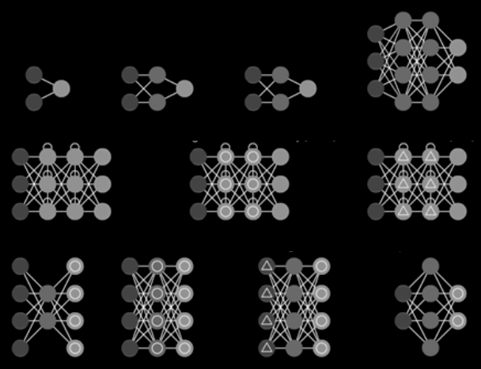
Databricks ML Runtime
Reliable and secure distribution of open source ML frameworks
Packages and optimizes most common ML Frameworks .
Customized Environments using Conda .
...
requirements.txt
conda.yaml
Built-in Optimization for Distributed Deep Learning .
Customization
Distribute and Scale any Single-Machine ML Code to 1,000’s of machines.
Built-In AutoML and Experiment Tracking .
Pre-configured Environment
AutoML and Tracking / Visualizations with MLflow
Machine Learning
Conda-
Based

Slide 11
Better Together ! ML lifecycle management with MLflow and Azure ML

Slide 12
Azure Databricks
Azure Machine Learning Service
Prepare and clean data at massive scale with the language of your choice on an optimized Apache Spark engine
Enable collaboration between data scientists and data engineers with an interactive workspace
Access pre-configured machine learning optimized Spark clusters
Increase data scientist productivity with automated machine learning
Native Azure Databricks and MLFlow integration to enable
A central model registry for the entire organization
Robust MLOps with Azure DevOps integration
Deploy and manage your models using containers to run them anywhere
Prepare and clean data at massive scale with the language of your choice on an optimized Apache Spark engine
Enable collaboration between data scientists and data engineers with an interactive workspace, where they can build and train machine learning models
Access pre-configured machine learning optimized Spark clusters

Slide 13



MLflow Components
Standard packaging format for reproducible ML runs
Folder of code + data files with a “MLproject” description file
Tracking
Projects
Models
Model Registry
Record and query experiments: code, data, config, results
Packaging format for reproducible runs on any platform
General model format that supports diverse deployment tools
Centralized and collaborative model lifecycle management
mlflow.org
github.com/mlflow

Slide 14

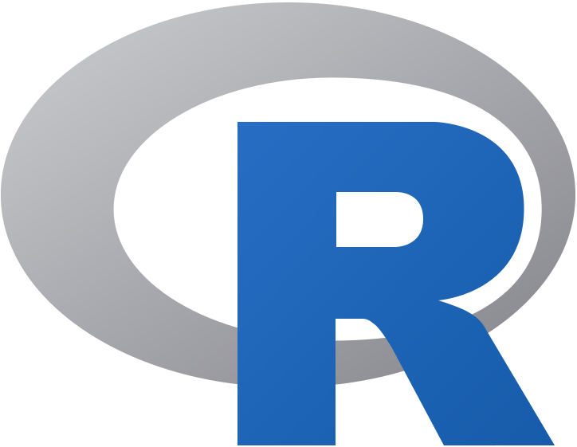


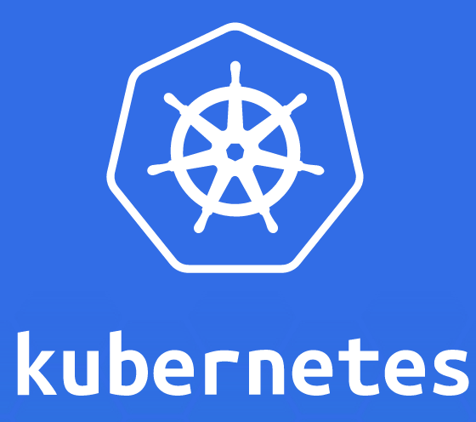



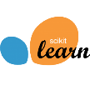




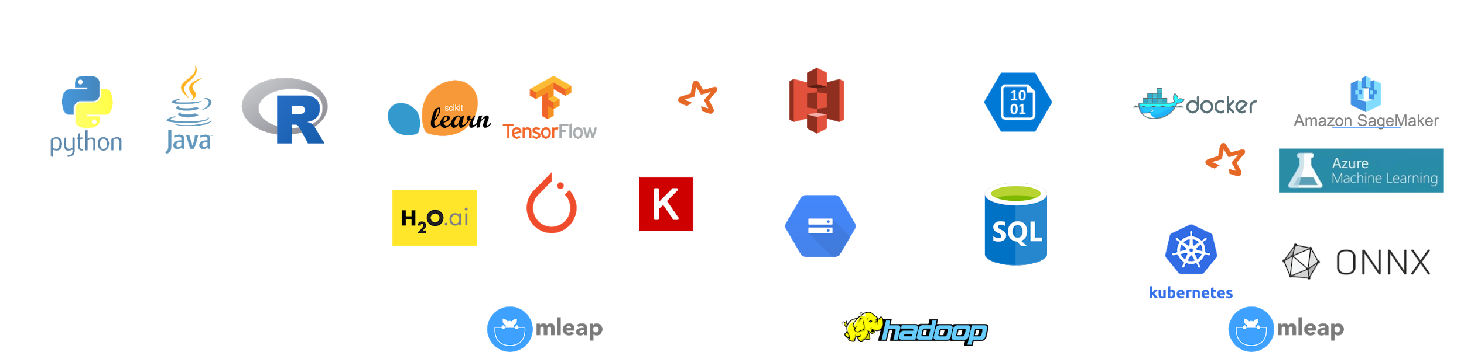
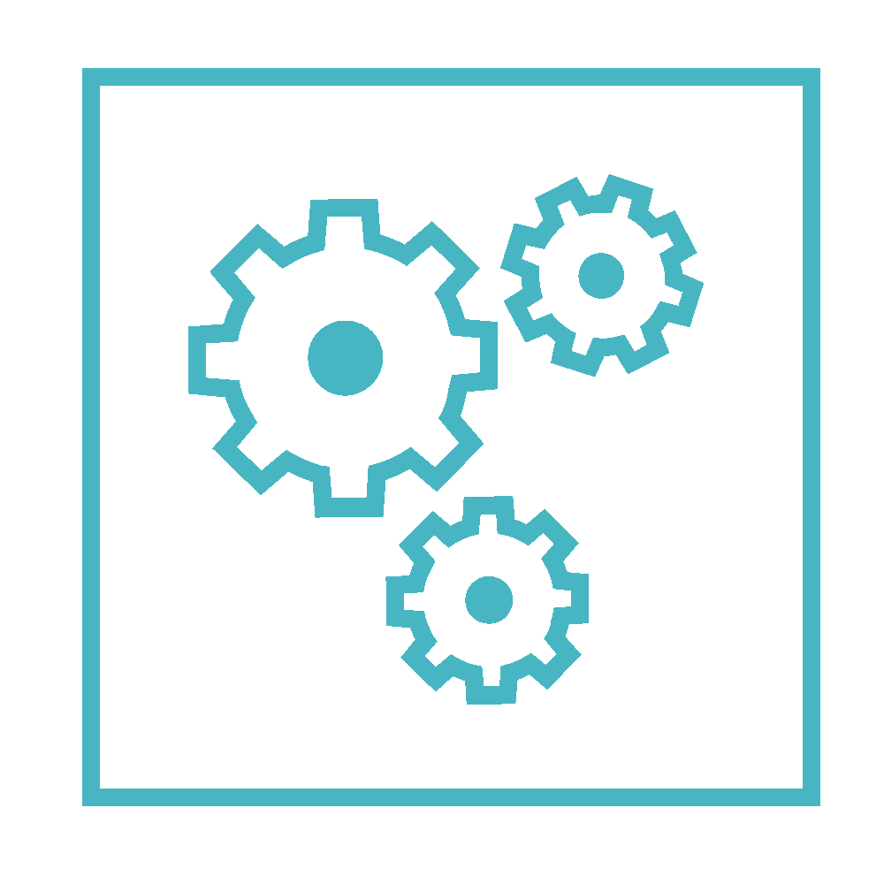
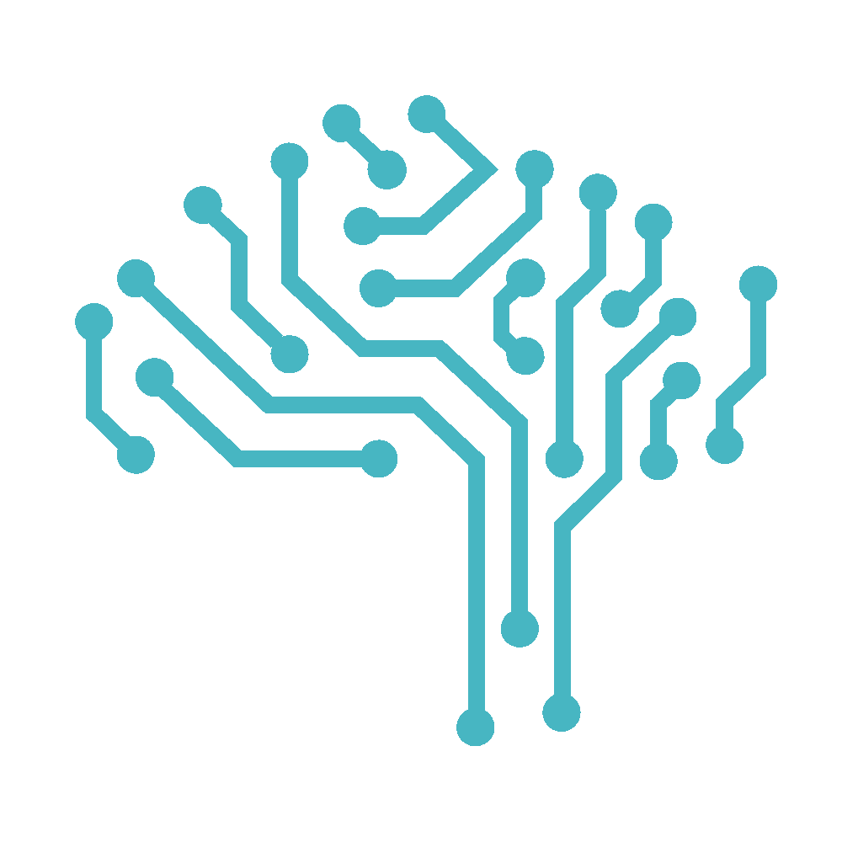


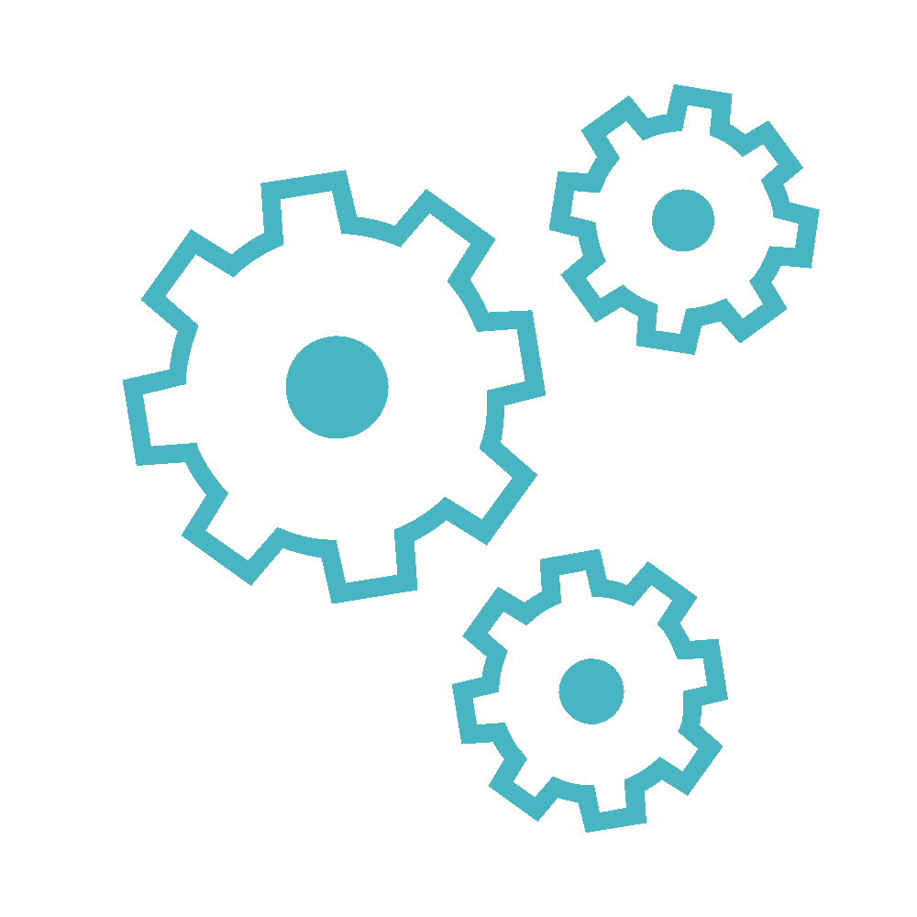
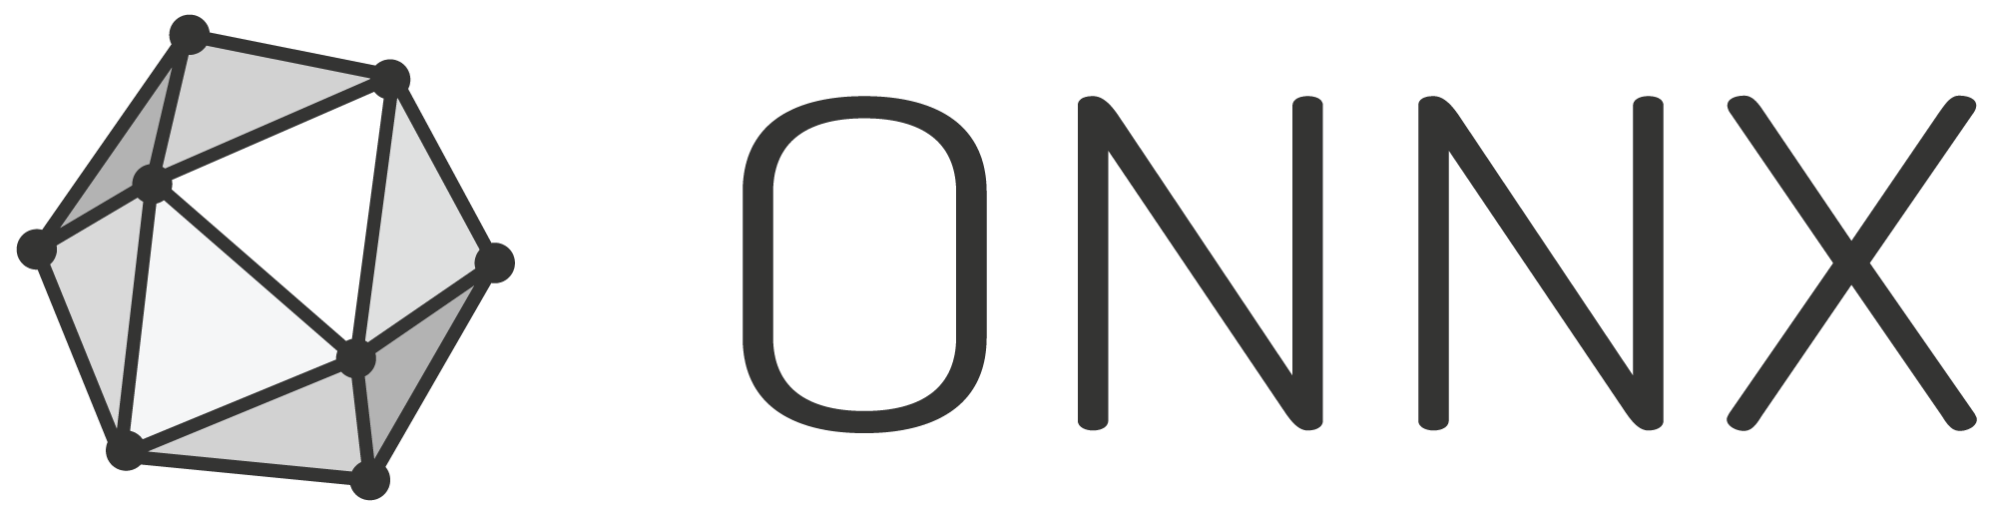
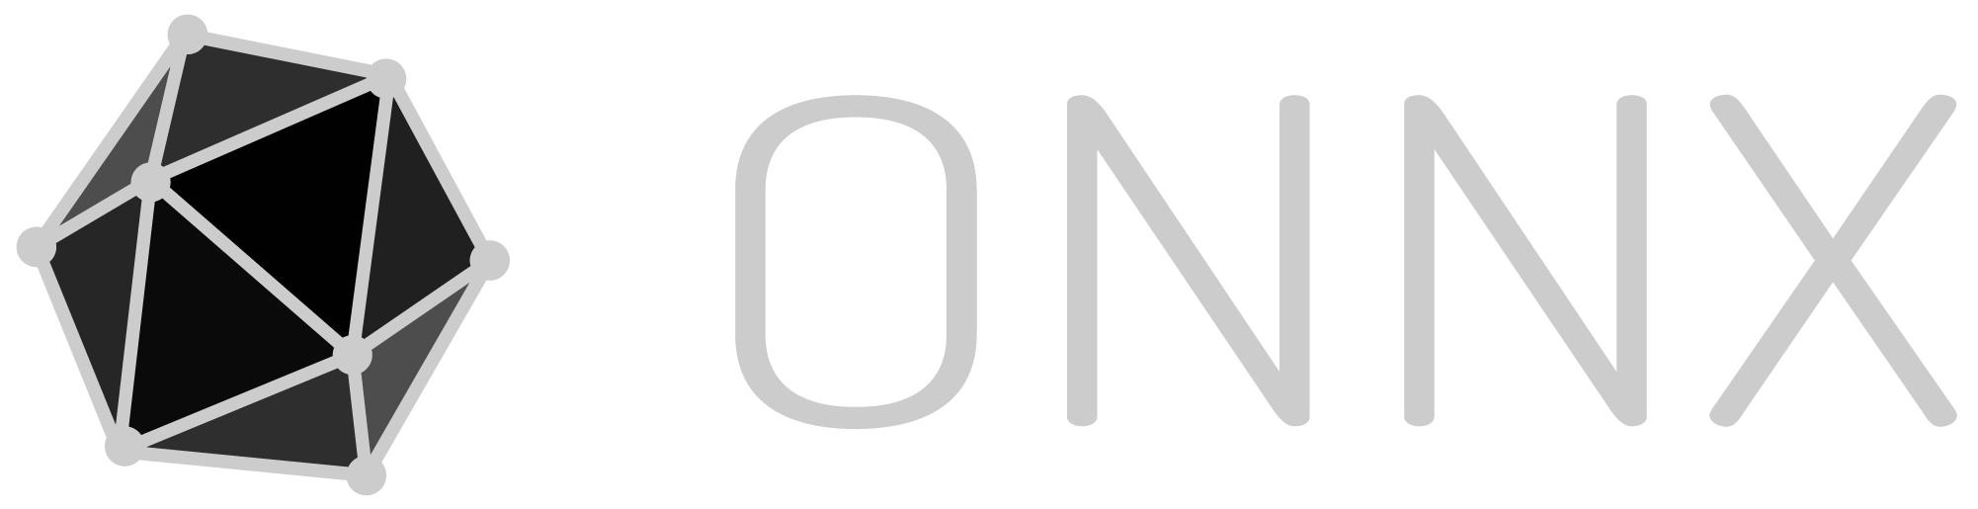

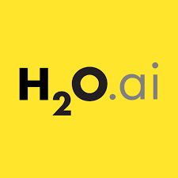
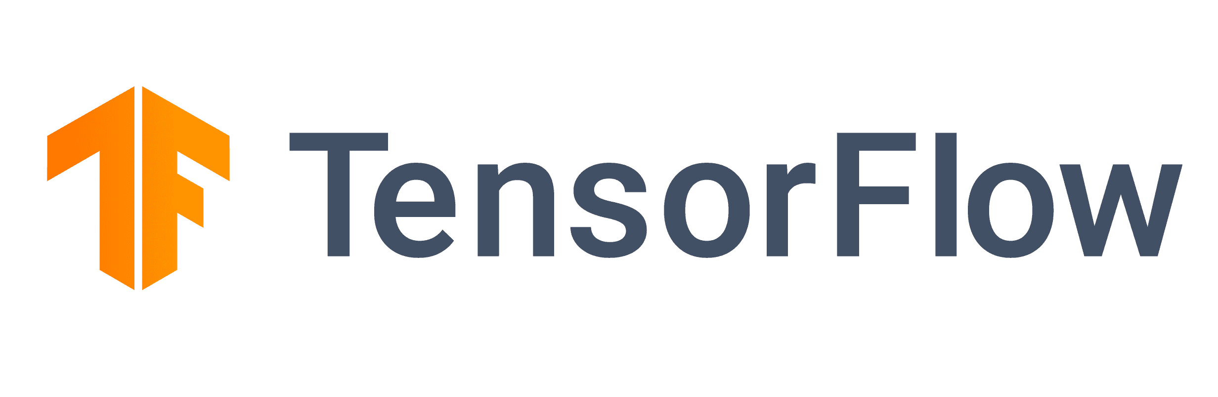
MLflow - Model Lifecycle
In-Line Code
Model Registry
Models
Tracking
Data Scientists
Deployment Engineers
Containers
Staging
Production
Archived
Flavor 1
Flavor 2
Batch & Stream Scoring
Parameters
Metrics
Artifacts
v1
Metadata
Models
v2
Cloud Inference Services
Custom
Models
v3
OSS Serving Solutions

Slide 15
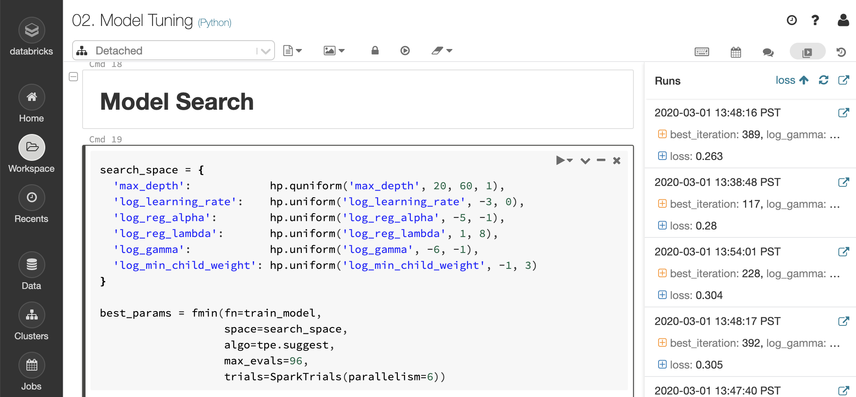
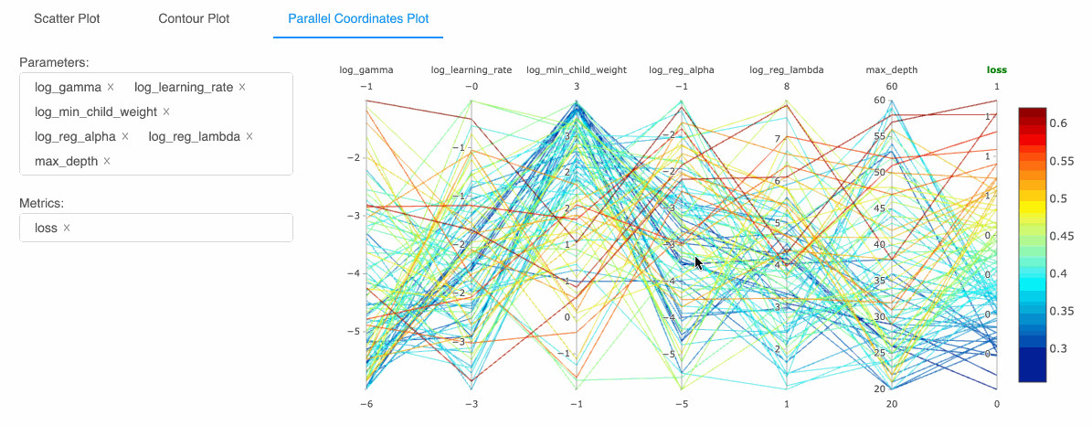
MLflow integration with Databricks - Tracking
SparkML, Keras, Hyperopt -> autlogging to MLflow

Slide 16
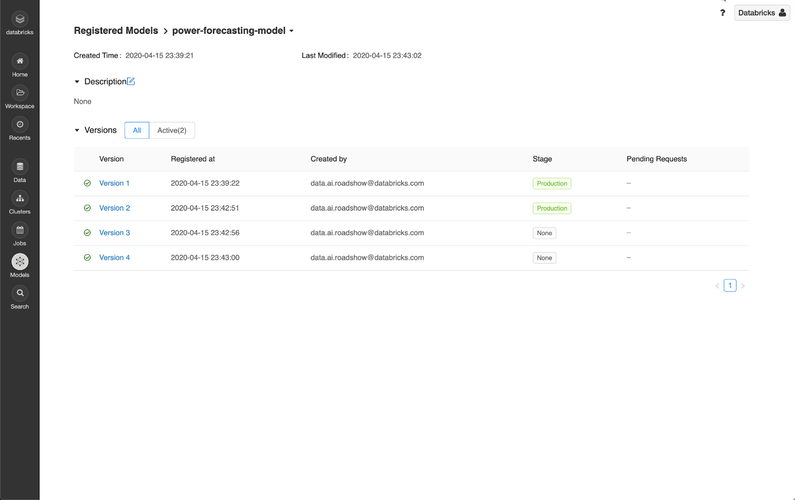
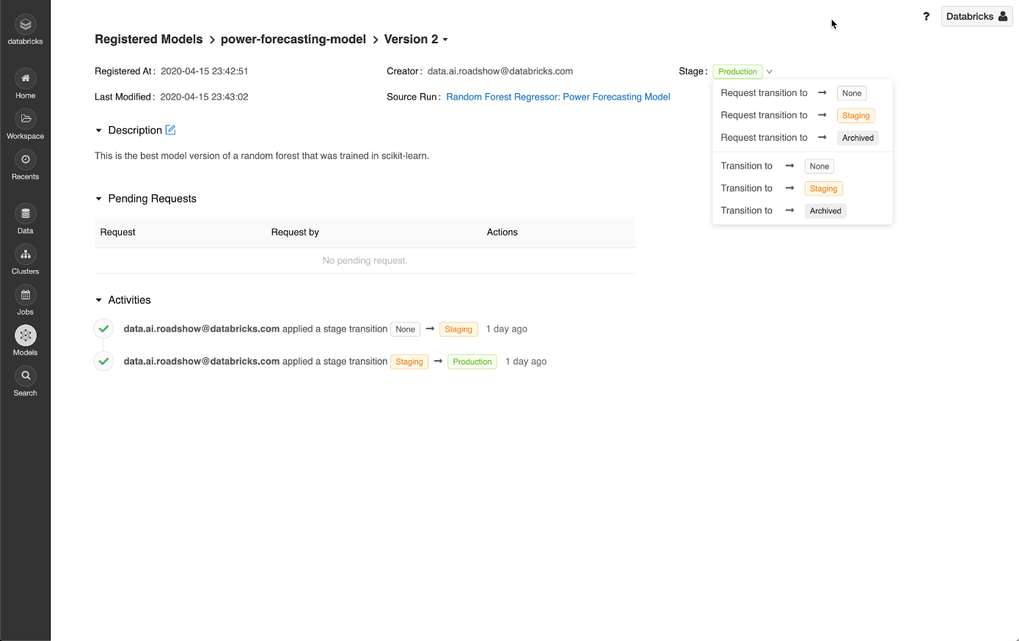
MLflow integration with Databricks - Model Registry

Slide 17

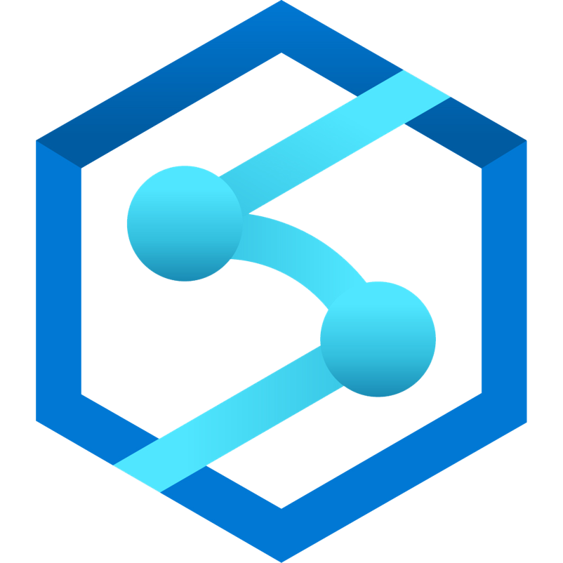
Data Science with Azure Databricks
Ingest
Store
Prep and train
Serve
Operational Databases
Streaming data
Azure Event Hubs
Cosmos DB, SQL DB
Apps
Azure Databricks
Azure ML
Ad-hoc analysis
Batch data
Azure Data Factory
Azure Data Lake Storage
Azure Synapse Analytics
Power BI
Notes:
Ben
Implementing advanced analytics solutions in your organization is a four-step process.
First, you need to ingest data from a variety of data sources, including batch and streaming data.
Azure HDInsight allows you to ingest data at scale in real-time
Azure Data Factory enables you to ingest structured and unstructured batch data at scale, in addition to orchestrating your data preparation processes
Then, you need to take in and store disparate data that’s being ingested regardless of data volumes, variety, and velocity.
With Azure Blob Storage, you can build data integration pipelines that span on-premises and cloud
Next, you need to cleanse, prepare, and train your data.
Azure Databricks enables data scientists and data engineers to collaboratively build and test ML and AI models in the fastest Spark environment
Finally, you need to model and serve this prepared data to your applications, bots, and agents.
Azure Cosmos DB offers low-latency for massively scalable applications
With Azure SQL Data Warehouse, you can easily integrate with leading BI solutions, such as Power BI
<Transition>: Today, we want to focus on preparing and training advanced analytics models.

Slide 18
Azure Machine Learning Service
Bring AI to everyone with an end-to-end, scalable, trusted platform
Built with your needs in mind
For all skill levels
Automated ML
Drag & Drop
Code First
Automated machine learning
Managed compute
Industry MLOps
Integration with MLflow
Integration with Azure DevOps
Simple deployment
DevOps for machine learning
Support for open source frameworks
Deploy and manage your models everywhere
Cloud service (ACI, AKS)
On-prem appliance
Edge device
Tool agnostic Python SDK
Notes:
Azure Machine Learning Services empowers you to bring AI to everyone with an end-to-end, scalable, trusted platform.
Boost your data science productivity
Python pip-installable extensions for Azure Machine Learning that enable data scientists to build and deploy machine learning and deep learning models
Now available for Computer Vision, Text Analytics and Time-Series Forecasting.
Increase your rate of experimentation
Rapidly prototype on your desktop, then easily scale up on virtual machines or scale out using Spark clusters
Proactively manage model performance, identify the best model, and promote it using data-driven insights
Collaborate and share solutions using popular Git repositories.
Deploy and manage your models everywhere
Use Docker containers to deploy models into production faster in the cloud, on-premises, or at the edge
Promote your best performing models into production and retrain them when their performance degrades
Azure Machine Learning Services are built with your needs in mind, providing:
GPU-enabled virtual machines
Low-latency predictions at scale
Integration with popular Python IDEs
Role-based access controls
Model versioning
Automated model retraining
(Optional: other services)
Azure Machine Learning Workbench integrates with ONNX models
Work with your ONNX models from Visual Studio Code Tools for AI.
Build deep learning models and call services straight from your favorite IDE easier with Azure Machine Learning services built right in.
Create a seamless developer experience across desktop, cloud, or at the edge.
AI Toolkit for Azure IoT Edge
MMLSpark is an open-source Spark package that enables you to quickly create powerful, highly-scalable predictive and analytical models for large image and text datasets by using deep learning and data science tools for Apache Spark.
Azure Machine Learning Services seamlessly integrates with the rest of the Azure portfolio.
<Transition>: Azure Machine Learning Services allows you to deploy models to many different production environments.

Slide 19
Right Environment for the User
 | Azure Machine Learning | Azure Databricks
Citizen Data Scientist (no-code) | ★★★ Studio / AutoML | NA
Traditional Data Scientist (code-first) | ★ Jupyter Notebooks | ★★★ Databricks Notebooks

Slide 20


Azure Databricks with Azure Machine Learning
Azure
Databricks
Engineered integration
Azure Machine Learning
Open & extensible
Leverage the latest libraries and frameworks
Perform distributed training across CPUs and GPUs
Dedicated ML runtime with pre-built optimizations
MLflow integration
Common experiment tracking and results backend
Store models in a central model registry across Azure
Combined view of all ML activity within Azure
ML & ML management
Package and deploy models for inferencing at scale
Leverage automated ML to design a model factory
Create CI/CD pipelines for retraining with drift tracking and audit trails
Azure DevOps
Implement MLOps with Azure DevOps
Powerful infrastructure with latest CPUs and GPUs

Slide 21
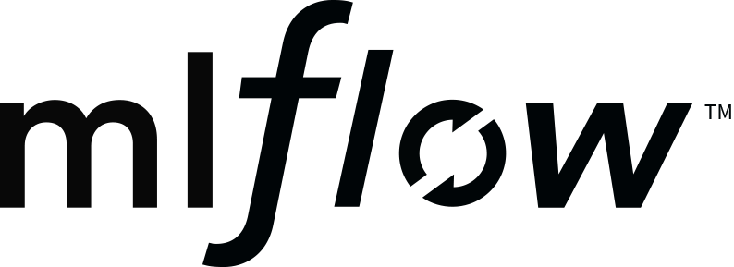

Azure Databricks and Azure ML are better together
Azure Databricks
AML SDK
Azure ML
Log experiments and models in a central place
Maintain audit trails centrally
Deploy models seamlessly via Azure ML
Implement robust MLOps
Notes:
Ben

Slide 22

MLflow with Azure Machine Learning
Data Scientist
Collaborate
Train model
Validate model
Deploy model
Monitor model
Track experiments
Track models
Track hyperparameters
Track model efficacy
Compare against other models
Track dependencies
Track images/containers
Track deployments
Model management
Drift Analysis
Audit trail management and model interpretability
Retrain model
Notes:
Ben
How ADB integrates in this slide?
Train the model – ADB
No shading of icons or one color shading for all

Slide 23
Data Science with Azure Databricks & Azure ML
Ingest
Store
Prep and train
Serve
Model Serving
Streaming data
Azure Event Hubs
Azure Kubernetes Service
Operational Databases
Apps
Azure Machine Learning
Azure Machine Learning
Cosmos DB, SQL DB
Azure ML
Azure Databricks
Ad-hoc analysis
Batch data
Azure Data Factory
Azure Data Lake Storage
Azure Synapse Analytics
Power BI
Notes:
Ben
Implementing advanced analytics solutions in your organization is a four-step process.
First, you need to ingest data from a variety of data sources, including batch and streaming data.
Azure HDInsight allows you to ingest data at scale in real-time
Azure Data Factory enables you to ingest structured and unstructured batch data at scale, in addition to orchestrating your data preparation processes
Then, you need to take in and store disparate data that’s being ingested regardless of data volumes, variety, and velocity.
With Azure Blob Storage, you can build data integration pipelines that span on-premises and cloud
Next, you need to cleanse, prepare, and train your data.
Azure Databricks enables data scientists and data engineers to collaboratively build and test ML and AI models in the fastest Spark environment
Finally, you need to model and serve this prepared data to your applications, bots, and agents.
Azure Cosmos DB offers low-latency for massively scalable applications
With Azure SQL Data Warehouse, you can easily integrate with leading BI solutions, such as Power BI
<Transition>: Today, we want to focus on preparing and training advanced analytics models.

Slide 24
Demo:
Track with MLflow, deploy with AzureML

Slide 25
Thank You!

Slide 26
Sample Notebooks
https://docs.microsoft.com/en-us/azure/databricks/applications/machine-learning/mllib/
https://docs.microsoft.com/en-us/azure/databricks/applications/mlflow/quick-start#notebooks
https://docs.microsoft.com/en-us/azure/databricks/applications/mlflow/tracking#--examples
https://docs.microsoft.com/en-us/azure/databricks/applications/mlflow/models#examples
https://docs.microsoft.com/en-us/azure/databricks/applications/machine-learning/automl/hyperopt/hyperopt-spark-mlflow-integration#--distributed-hyperopt--automated-mlflow-tracking-notebook
https://docs.microsoft.com/en-us/azure/databricks/applications/machine-learning/automl/hyperopt/hyperopt-distributed-ml#hyperopt-and-horovodrunner-distributed-training-notebook
https://docs.microsoft.com/en-us/azure/databricks/applications/machine-learning/automl/mllib-mlflow-integration#automated-mlflow-tracking-notebook
https://docs.microsoft.com/en-us/azure/databricks/applications/machine-learning/third-party/

